Slide 1



If you Helm chart is insecure, your pet LLM can fix it, can’t it?
2025, 19 June 2025
Fabio Massacci
Joint work with Agathe Blaise, Francesco Minna, Katja Tuma

Slide 2
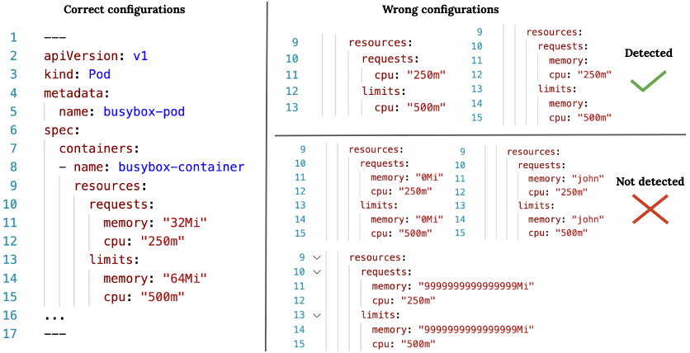
Examples of Misconfigurations
Correct Configurations
Wrong Configurations
Detected
Not Detected

Slide 3
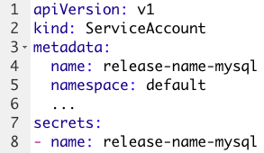
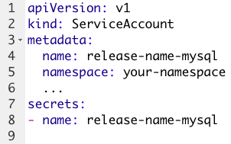
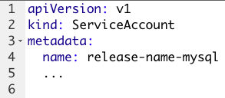
Examples of fixes
Gemini refactoring
Removed the namespace (still the default)
Removed additional information
ChatGPT refactoring
Changed the namespace to not-default
Original misconfiguration with default namespace

Slide 4
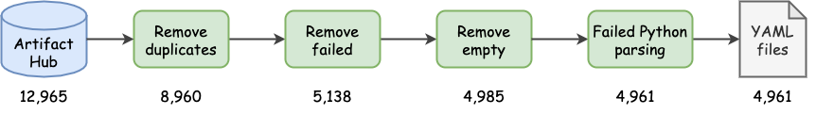
Let’s go big…
 | Min | 1st quart. | Median | 3rd quart. | Max | Mean | SD
Containers | 0 | 1 | 1 | 2 | 56 | 2.2 | 3.3
Lines | 8 | 106 | 278 | 384 | 53,691 | 701 | 193

Slide 5
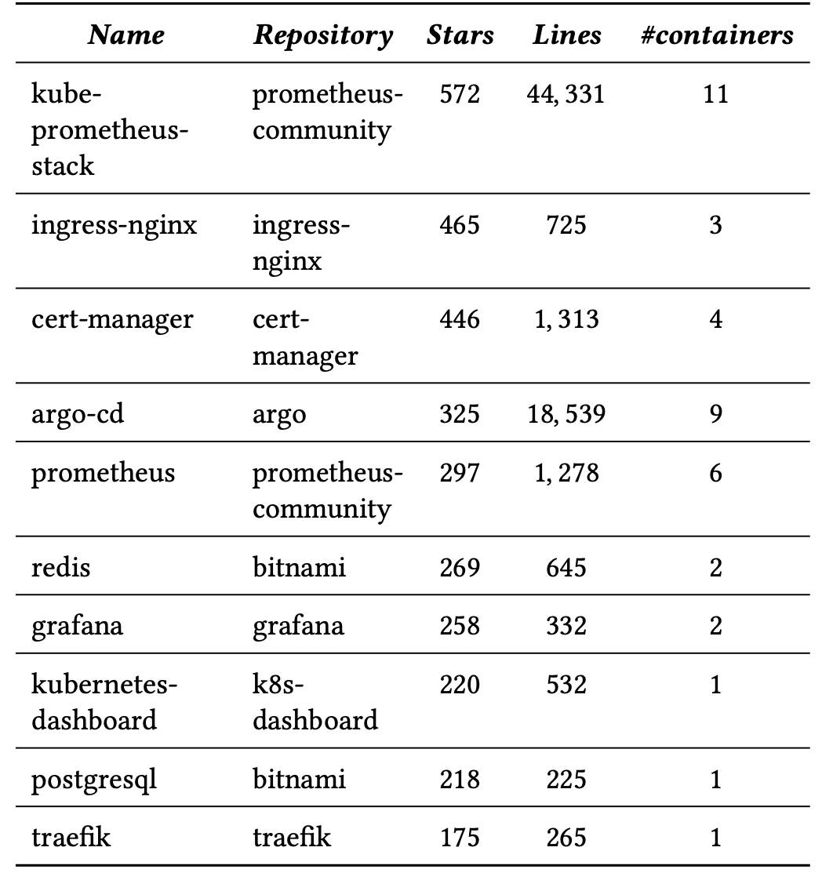
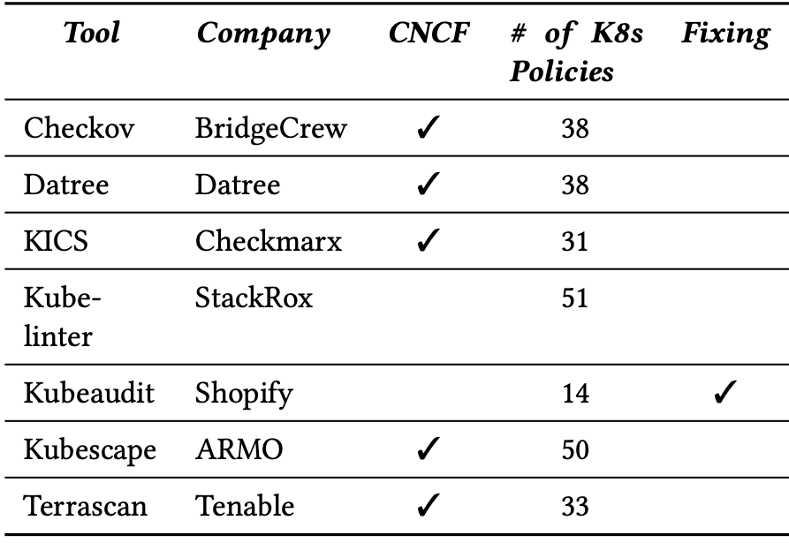
Let’s start Top 60 Helm charts vs static analyzers
Helm Charts analyzer tools
Top 10

Slide 6
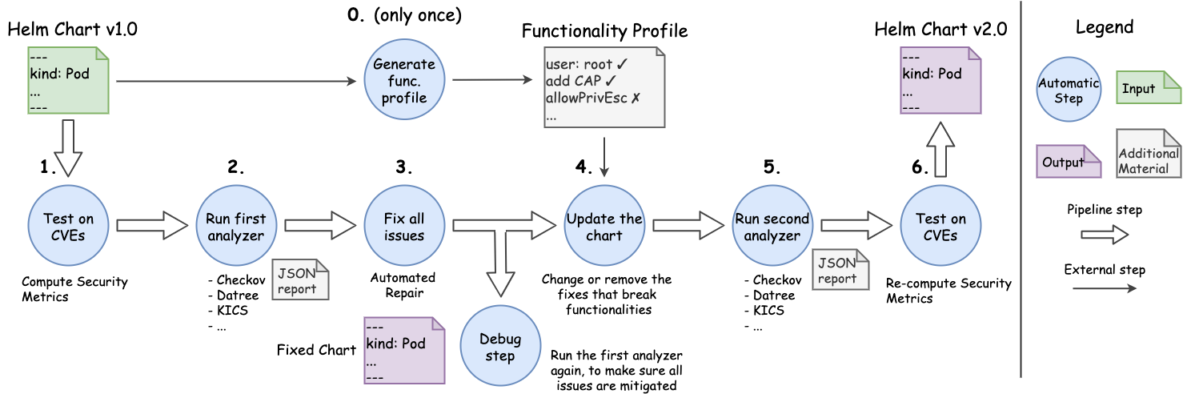
Building an Evaluation Workflow
Goal: functional configuration with least privilege
.
Plug-and-play pipeline

Slide 7
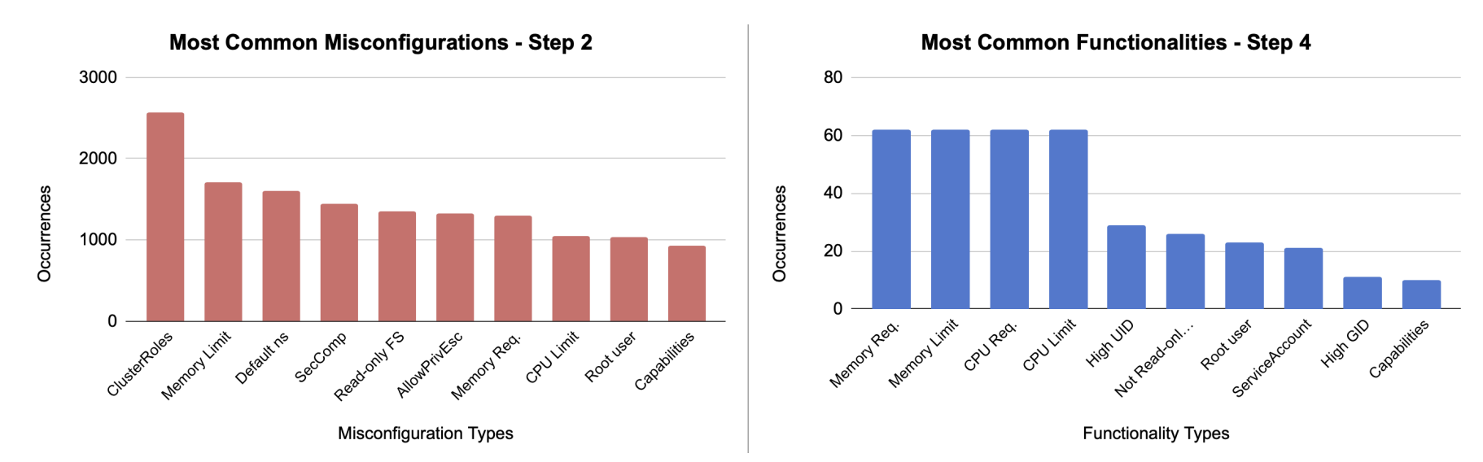
Top 10 security misconfigurations…
On the Top 60 charts
On the whole set of Artifact Hub
Median of 6-24 misconfigurations per chart depending on the tool
Using default namespaces or Missing Limits → reasonable misconfigurations for «templates»
Bad security practices → not read-only file systems, privilege escalation, root users, capabilities
Just remove them, don’t you?

Slide 8
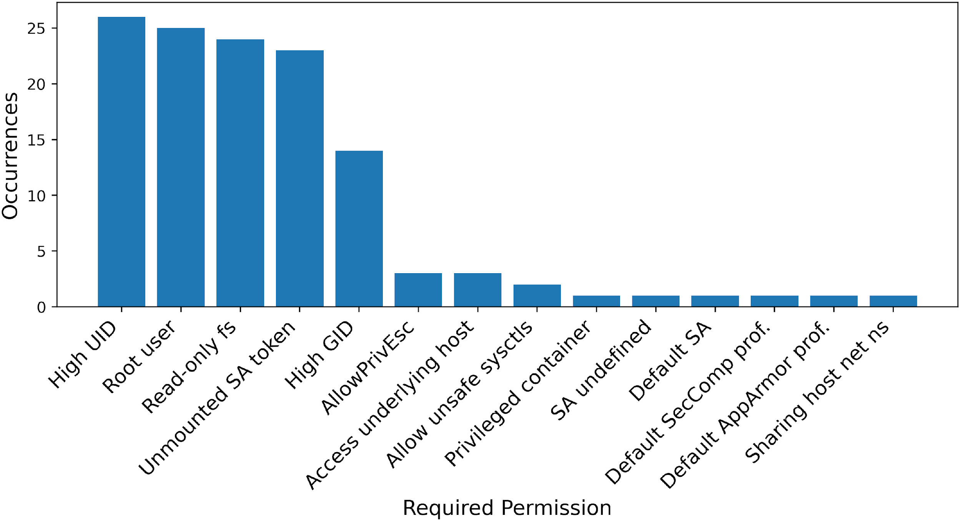
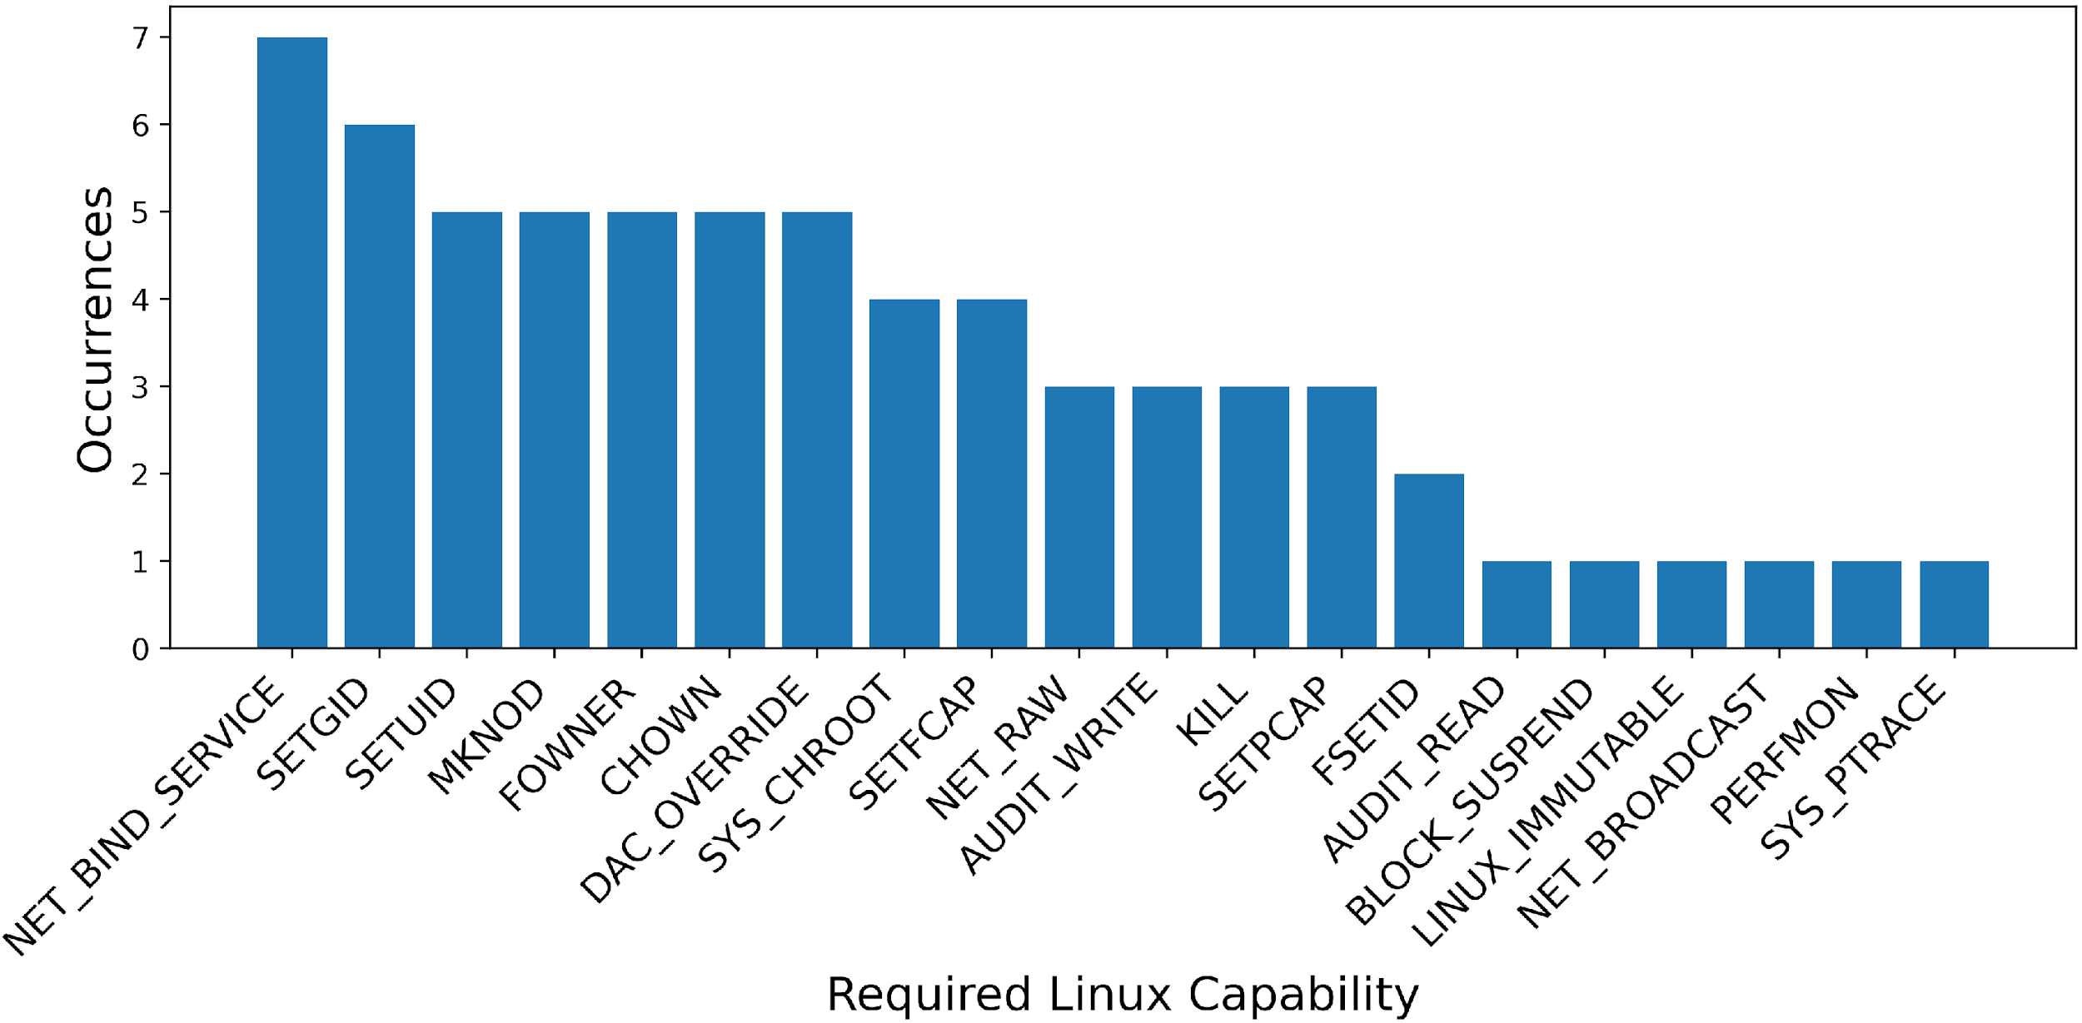
Removing permissions will break 26 out of 60 top containers
“NET_BIND_SERVICE” (run on privileged ports) is effectively required for 7 containers
“Prevent containers from accessing host files by using high UIDS” (root is 0) failed for 26 containers

Slide 9
LLMs vs Helm Charts
 | GPT-4o-mini-024-07-1 | Gemini 1.5 | Claude-3-sonnet | Llama 3-70b
Input Tokens | 128K | 1,048K | 40K | 8K
Output Tokens | 16K | 8K | 8K | 2K
 | 1st Q | Median | Mean | 3rd Q | Max
Lines | 106 | 278 | 704 | 384 | 53,691
278-704 lines/container x
>>20 chars/lines /
4 chars/token =
>> 1-2K tokens/container

Slide 10
Taming the token limits
The Input
The output
Charts are just too big, too many parentheses, etc.
And you need the prompt as well!
Each warning impact either one line or at most one YAML resource
affected object (e.g., Pod, or Deployment), deployment namespace, and name → uniquely identify the YAML resource
So we ask to refactor the snippet
1. Ask the LLM to refactor the snippet
2. Test the snippet
But what if the LLMs changes make it unworkable?
E.g deleted of changed irrelevant lines that are however needed to work.
3. Put back the snippet into the original place and see what happens

Slide 11
LLMs have can do a lot of fixes…
Checking the snippet alone
By policy is not so uniform
Using default namespace → GPT rocks, Claude sucks
Missing AppArmor profile → GPT sucks, Claude rocks
Not using high UIDs -→ all paltry 50% something
Missing ResourceQuota → they are all bad only Claude make 25%
 | Fixed | NOT fixed | Crashed
Claude | 58% | 38% | 3%
GPT | 83% | 16% | 1%
Gemini | 76% | 11% | 13%
LLama | 78% | 10% | 13%

Slide 12
The manual validation process…
The process
The outcome
90
Ask LLM to fix it
Run Tool on snippet → Apparent Fix
Review snippet → Real Fix
Merge snippet in Chart
Run Tool on Chart → Apparent Fix
Review chart → real fix
Run on the snippet
89
Review
69
Run on the chart
86
Review
64
APPARENT SUCCESS = 94%
REAL = 67%

Slide 13
Putting it all together
We look at the snippet…
Conclusion is…
LLMs are not a disaster but don’t work that great
= there are some but not enough good examples on the internet ☺
 | Fixed out of 4K | Real out 100% | Just the product | CI-95%
Claude | 58% | 79% | 46% | 36%-56%
GPT | 83% | 67% | 56% | 45%-65%
Gemini | 76% | 27% | 21% | 13%-30%
LLama | 78% | 0% | 0% | 3%-13%

Slide 14
Prompt Engineering is the wrong goal…
What people always ask
is ALWAYS the wrong point
What people ask
Are there false positives in the analyzer tool results and hallucinations in LLM refactoring?
…needs deeper investigations about the failure, … why they failed, and how the prompt can be changed …
We also initially attributed human traits
«Would it read the whole context?»
«Which style is considering for Helm Charts?»
LLM is a probabilistic summary of what its owner found on the internet!
Right frame of mind
«Are there enough examples on the internet with the fix and the context?»
«Which HELM charts are used in the LLM’s owner IaC repositories?»
Why LLM failed?
«There are not enough good examples selected by the words in the prompt.» → that’s it kid, give reality a break
Do you remember Google returning black people photos when asked for gorillas? Same here.

Slide 15
Time to take away something
Object Level
Meta-level
Security misconfigurations are a lot
But they are not always misconfigurations → you might need security privileges
LLM are good to suggest developers potential fixes
But you need a human to review fixes before deploying it
in the best case we have at most 65% that are fixed but can go down to few %
Do not run a pipeline and brag about the results → including «implications for developers»
Check results for breaking changes
Check results for true correctness
So the final result should never be
we run our pipeline on 4K YAML files and 83% cand be automatically fixed by LLMs
But: between x% and y% could be potentially fixed

